Slide 1
MATLAB
Class 6: data reduction

Slide 2
What is data reduction?
Can you describe your crush along the following dimensions: Hair, height, eye colour, smile, personality

Slide 3
What is data reduction?
Can you describe your crush along the following dimensions: Hair, height, eye colour, smile, personality
Can you describe your crush on the same dimensions using fewer words?

Slide 4
Why would you want to reduce your dimensions
Data sometimes comes to us in a high dimensional space (e.g., EEG recordings from 200+ electrodes). While we are interested in global patterns we may not be interested in every electrode. We want a way to summarize information across the hundred of variables (i.e., electrodes)

Slide 5
Data reduction
Like a questionnaire in psychology research, observations of all your measures (i.e., questions on a questionnaire) can be described by latent variables that may be of interest to you (i.e., personality)

Slide 6
Data reduction
Do you adapt to all situations?
Do people describe you as carefree?
Are you witty?
Are you a good communicator?
Are you charming?

Slide 7
Data reduction
YOU’RE A GEMINI
Do you adapt to all situations?
Do people describe you as carefree?
Are you witty?
Are you a good communicator?
Are you charming?

Slide 8
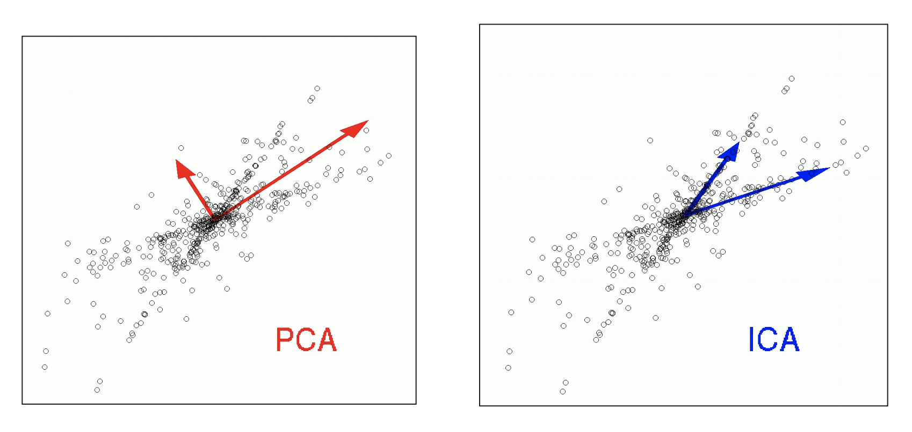
ICA vs PCA

Slide 9
Principal Component Analysis
Principal Component Analysis (PCA) extracts relevant orthogonal features, that we call Principal Components, from a large pool of variables.
In PCA we attempt to find dimensions that maximize variance

Slide 10

Set operations
Principal Component Analysis (PCA) extracts relevant orthogonal features, that we call Principal Components, from a large pool of variables.
In PCA we attempt to find dimensions that maximize variance

Slide 11
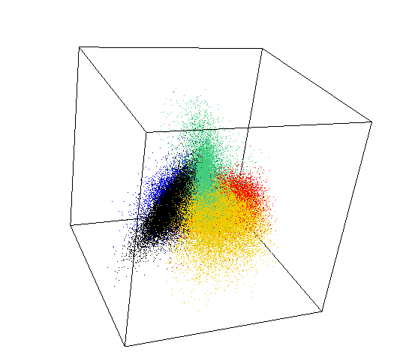

Methods: PCA
Principal Component Analysis (PCA extracts relevant features, that we call Principal Components, from a large pool of variables
Each Principal Component describes a new set of orthogonal dimensions in your data that maximize the variance

Slide 12
PCA
[coeff, score, latent, tsquared, explained, mu] = pca(X)
X -> data matrix (m by n) to apply PCA (rows observations, col variables)
Coeff -> matrix (n by n) PCA coefficients each col is one PC, rows are weights for your variables
Score -> matrix (m by n) how much a given observation ‘scores’ or ‘loads’ onto a PC

Slide 13
PCA
[coeff, score, latent, tsquared, explained, mu] = pca(X)
Latent -> eigenvalues of the covariance matrix of X
Tsquared -> Sum of squares of standardized scores
Explained -> Percent variance explained per component
Mu -> estimated means of each variable

Slide 14

PCA
[coeff, score, latent, tsquared, explained, mu] = pca(X)
Latent -> eigenvalues of the covariance matrix of X
Tsquared -> Sum of squares of standardized scores
Explained -> Percent variance explained per component
Mu -> estimated means of each variable

Slide 15
Normalizing data
In Generally, you want to normalize your data BEFORE running a PCA both by subtracting the mean of each column and dividing by the standard deviation of each column
You can’t compare apples to oranges or cm to volts

Slide 16


Slide 17
A Note
Since PCA is a linear transformation, translating our data into a new space, we can simply rotate it back to where it began:
Original_data = score*coeff ' + mean(data);
Where the score is the loadings of the components and coeff is the weights matrix that was used to rotate your data.
Notice how we add back the mean of our Original data.

Slide 18

A Note
Since PCA is a linear transformation, translating our data into a new space, we can simply rotate it back to where it began:
Original_data = score*coeff ' + mean(data);
Where the score is the loadings of the components and coeff is the weights matrix that was used to rotate your data.
Notice how we add back the mean of our Original data.

Slide 19
A Note
Since PCA is a linear transformation, translating our data into a new space, we can simply rotate it back to where it began:
Original_data = score*coeff ' + mean(data);
Where the score is the loadings of the components and coeff is the weights matrix that was used to rotate your data.
Notice how we add back the mean of our Original data.

Slide 20
A Note
Since PCA is translating our data into a new space, we can simply rotate it back to where it began:
Original_data = score*coeff ' + mean(data);
Where the score is the loadings of the components and coeff is the weights matrix that was used to rotate your data. Notice how we add back the mean of our Original data.

Slide 21
ICA

Slide 22
Blind Source Separation Problem
Problem described in mathematics where there are two signals (i.e., sources) that you must disentangle from one another. But how do we go about solving this problem?

Slide 23




Blind Source Separation Problem
Our brain does it naturally through selective attention:
Mariah Carey: Honey
Madonna: Ray of Light

Slide 24
Blind Source Separation Problem
Our brain does it naturally through selective attention:
Hidden Variables
Mariah Carey: Honey
Madonna: Ray of Light
Observations

Slide 25
Blind Source Separation Problem
Our brain does it naturally through selective attention:

Slide 26

Blind Source Separation Problem
Our brain does it naturally through selective attention:
Mariah Carey: Honey
Madonna: Ray of Light

Slide 27
Independent Component Analysis
Independent component analysis is one way we have approached this problem mathematically.
This algorithm attempts to decompose a complex signal into its many sub-signals or sources

Slide 28
Independent Component Analysis
Thus, it answers a different question than PCA
Whereas PCA answers the question how can you represent your data with new dimensions, ICA asks what sources make up your complex signal

Slide 29
Independent Component Analysis
ICA finds components that are statistically independent from one another (i.e., independent sources)
There are various methods to solve this (e.g., FastICA, infomax etc.) That rely on different strategies like minimizing the Mutual Information between components

Slide 30
ICA
[mdl] = rica(X,q)
X -> data matrix (m by n) to apply ICA (rows observations, col predictors)
Q -> is the number of features or dimensions you wish to extract
mdl -> struct containing result of ICA

Slide 31
ICA
Mdl
mdl.mu -> mean along dimensions
mdl.TransformationWeights -> matrix used to rotate your data
mdl.NumPredictors -> same as the number of columns of X
mdl.NumLearnedFeatures -> same as the input q

Slide 32
ICA
Use the function transform(MDL, X) to rotate your data X to the new dimensions using the transformation weights
This is the equivalent to the score in PCA
To project back to the original data you need to multiply the scores by the transformation weights

Slide 33
A Note
ICA is typically used to remove components or sources from your data (i.e., clean the data of artifacts)
Similarly, ICA is used to extract sources from noisy data
This is a type of feature extraction if you believe your data is coming from a fixed number of independent sources which are linearly mixed together.

Slide 34





A Note
Underdetermined matrices occur when you have less observations than you have sources (i.e., more songs mixed together than microphones to record the songs) . This may make finding the sources more difficult.
Sometimes we know how many sources we want to unmix from our data, or the source itself, other times we do not know the number or identity of the source

Slide 35

Lets Compare ICA & PCA

Slide 36

Lets Compare ICA & PCA

Slide 37
Lets Compare ICA & PCA
What would PCA do if you fed the algorithm a piece of this delicious cake?

Slide 38
Lets Compare ICA & PCA
What would ICA do if you fed the algorithm a piece of this delicious cake?

Slide 39
Lets Compare ICA & PCA
PCA
Finds orthogonal components
Finds components that maximize variance
Features ordered in terms of variance explained
ICA
Finds Statistically Independent (⬇️ MI) components
Solution for the blind source separation problem
Finds components that share no Mutual Information

Slide 40
We can similarly reduce data by categorizing it into groups

Slide 41
K-means
The previous techniques allow you to reduce data in terms of their dimensions, attempting to describe observations along new dimensions that are more interesting to you
We can also reduce data by clustering or grouping them into a smaller number of cliques

Slide 42

K-means

Slide 43
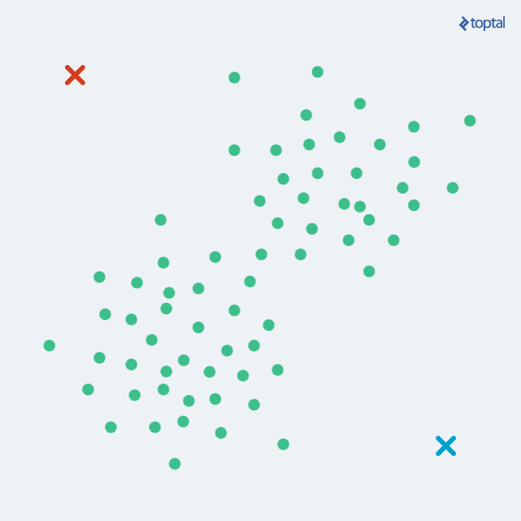
K-means
An algorithmic way to determine which cluster a given observation belongs to
Based on a simple strategy where you move k clusters around a feature space F trying to reduce the distance between your data and the cluster k

Slide 44


Slide 45
K-means
We randomly place two centroids k1 (red) and k2 (blue).
We then compute the distance between each data point and both centroids.
Classify each data point based on which centroid they are closest too

Slide 46
K-means
Move the centroids (red and blue) to the center of the data they are associated with
Repeat the above steps until the centroids stop moving around the feature space

Slide 47
K-means
It is necessary to standardize your data BEFORE running K-means. You want your features on equal footing. Features with large means or variance could be weighted more than your other features (i.e. meters vs micro volts)

Slide 48
Determining how many k is too many k
You can do this with a training and testing set. This is highly recommended as to avoid overfitting (see class 7)
Splitting your data into different subsets is common in machine learning algorithms
Normally you will have a large dataset to train on (i.e., teach your algorithm) and a smaller set to test if your algorithm works (i.e., see if it still works with new data)

Slide 49
Determining how many k is too many k
If you do not know apriori how many different classes or categories exist in your data, you need to compute this parameter
The optimal value of k is determined several ways:
Calinski-Harabasz criterion
Silhouette plots
Davies Bouldin index

Slide 50
Determining how many k is too many k
Calinski-Harabasz criterion
Ratio of between cluster dispersion against within cluster dispersion
Tight-knit clusters that are further apart get better scores, are described as better defined clusters

Slide 51
Determining how many k is too many k
Silhouette plots
For each point, measures how similar the observation is to its cluster. Values range from -1 to 1, unrelated to very related respectively
When looking at silhouette plots, one should expect to see all positive values that are very high (a ‘box’ per cluster)

Slide 52
Determining how many k is too many k
Davies Bouldin index
Compares the distance between clusters against the size of the cluster itself. Favours small clusters that are father apart

